Slide 1
Analyzing Virat Kohli's ODI Batting Performance
Unlocking Virat Kohli's ODI Legacy: A Detailed Exploration of Runs, Strike Rates, Boundary Shots, Sixes, Opposition Match-ups, and Dismissal Patterns. Delving into Kohli's Performance Spectrum from August 8, 2008, to January 22, 2017, to Reveal Insights and Trends Shaping His Cricketing Journey.

Slide 2
SAMPLE DATA
No | Runs | BF | 4s | 6s | SR | Pos | Dismissal | Inns | Opposition | Ground | Start Date
1 | 12 | 22 | 1 | 0 | 54.54 | 2 | lbw | 1 | v Sri Lanka | Dambulla | 18-Aug-08
2 | 37 | 67 | 6 | 0 | 55.22 | 2 | caught | 2 | v Sri Lanka | Dambulla | 20-Aug-08
3 | 25 | 38 | 4 | 0 | 65.78 | 1 | run out | 1 | v Sri Lanka | Colombo (RPS) | 24-Aug-08
4 | 54 | 66 | 7 | 0 | 81.81 | 1 | bowled | 1 | v Sri Lanka | Colombo (RPS) | 27-Aug-08
5 | 31 | 46 | 3 | 1 | 67.39 | 1 | lbw | 2 | v Sri Lanka | Colombo (RPS) | 29-Aug-08
6 | 2 | 2 | 0 | 0 | 100 | 7 | not out | 1 | v Sri Lanka | Colombo (RPS) | 14-Sep-09
7 | 30 | 41 | 3 | 0 | 73.17 | 4 | caught | 2 | v Australia | Vadodara | 25-Oct-09
8 | 10 | 16 | 1 | 0 | 62.5 | 3 | caught | 2 | v Australia | Mohali | 2-Nov-09
9 | 27 | 19 | 4 | 0 | 142.1 | 7 | bowled | 1 | v Sri Lanka | Rajkot | 15-Dec-09
10 | 54 | 65 | 7 | 0 | 83.07 | 4 | lbw | 1 | v Sri Lanka | Nagpur | 18-Dec-09
11 | 107 | 114 | 11 | 1 | 93.85 | 4 | caught | 2 | v Sri Lanka | Kolkata | 24-Dec-09

Slide 3
INFORMATION OF DATA
Here we are given a dataset of all the ODI matches played by Virat Kohli from 18 August 2008 to 22 January 2017.
This is the complete information about all the columns in the dataset:
Runs : Runs in the match (int64)
BF : Balls faced in the match (int64)
4s : number of 4s in a match (int64)
6s : number of 6s in a match (int64)
SR : Strike Rate in the match (float64)
Pos : Batting Position in the match (float64)
Dismissal : How Virat Kohli got out in the match (object)
Inns : 1st and 2nd innings (int64)
Opposition : Who was the opponent of India (object)
Ground : Venue of the match Start Date: Date of the match (object)
There are 132 Not Null Rows in this dataset.

Slide 4
TOTAL RUNS SCORED BY VIRAT KOHLI IN MATCHES
Virat Kohli has scored over 6184 runs in his ODI matches from 18 August 2008 to 22 January 2017

Slide 5
VIRAT KOHLI'S BATTING AVERAGE IN MATCHES
Virat Kohli averaged 46 - 47 runs in ODI matches from August 18, 2008, to January 22, 2017.
AVERAGE = 46.85

Slide 6
VIRAT KOHLI'S ODI BATTING POSITION
From August 18th to January 22nd, 2017, Virat Kohli consistently performed well in cricket matches, usually ranking among the top seven batsmen.
From this analysis, we can conclude that Virat Kohli usually bats in the 3rd position.

Slide 7
VIRAT KOHLI'S RUN AGAINST BATTING POSITION
Virat Kohli's highest run-scoring tendency occurs when he bats in the third position.
But Virat Kohli tends to score more runs when batting in the 3rd or 4th position

Slide 8
RUNS AND CENTURIES : FIRST VS. SECOND INNINGS
Virat Kohli usually plays very well in the second inning of ODI matches.
Virat Kohli frequently scores centuries in the second innings of ODI matches.

Slide 9
ANALYSE : DISMISSAL
Virat Kohli get caught out more frequently than other dismissal methods.

Slide 10
RUNS AND CENTURIES AGAINST OPPOSITION TEAMS
Virat Kohli scores most of his runs against the Sri Lanka cricket team
Virat Kohli scores his centuries when playing against the Australian cricket team.

Slide 11
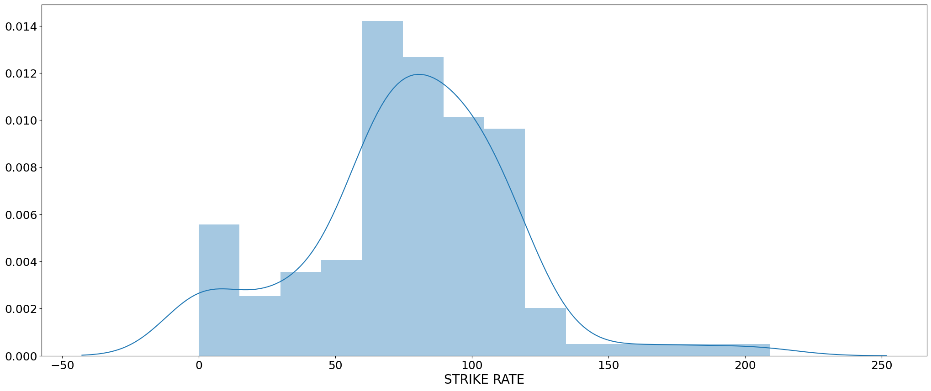
ANALYSE STRIKE RATE :
We can observe that Virat Kohli typically maintains a strike rate in the range of 60-80.

Slide 12
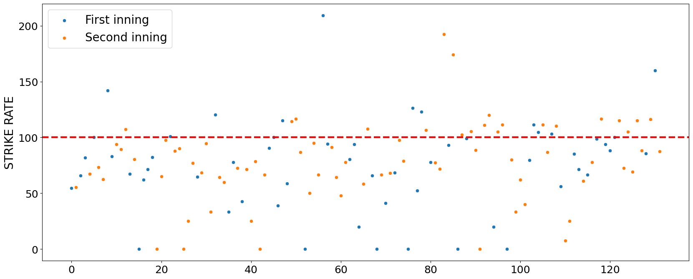
HIGH STRIKE RATE :FIRST VS. SECOND INNINGS
Virat Kohli scores quickly in both the first and second innings of cricket matches.
However, it's noticeable that he tends to have even higher strike rates during the second innings.

Slide 13
RILATIONSHIP BETWEEN RUNS AND 4S :
There was Linear relationship between the number of fours hit and the total runs scored.

Slide 14
RILATIONSHIP BETWEEN RUNS AND 6S :
There was not any relationship between the number of sixes hit and the total runs scored.

Slide 15
THANK YOU

